Slide 1

CS654: Digital Image Analysis
Lecture 2: Image Acquisition and Digitization
Image courtesy: Digital Image Processing, 3rd Edition, Gonzalez and Woods

Slide 2
Recap of Lecture 1
Introduction to the subject
Applications of image analysis
Areas of focus for this course
Relationship with other subjects

Slide 3
Outline of Lecture 2
Digital images and Human visual system
Image accusation
Explain the importance of image digitization
Why digitize
What is digitization
How to digitize
Sampling and Quantization
Size space trade-off

Slide 4
Digital Image
First picture of moon from US space craft

Slide 5
Electromagnetic spectrum

Slide 6
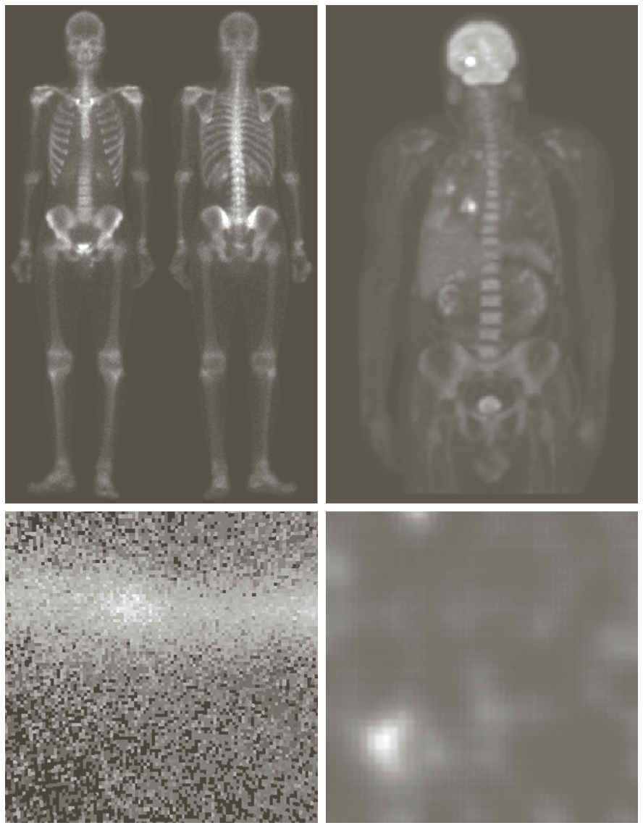
Images from different modalities
Gamma-ray

Slide 7
Images from different modalities
X-ray

Slide 8
Images from different modalities
Ultra violate

Slide 9
Images from different modalities
Light
microscopy

Slide 10
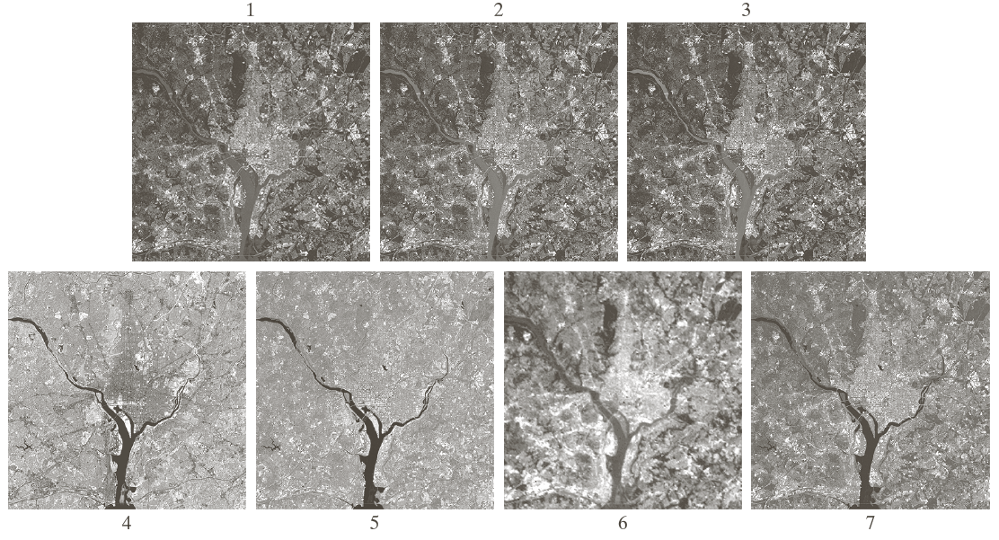
Images from different modalities
Satellite images

Slide 11
Images from different modalities
Visible spectrum
images

Slide 12
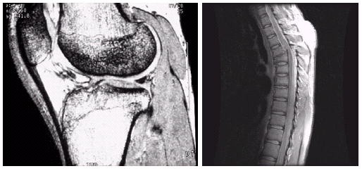
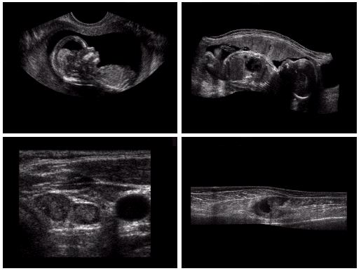
Images from different modalities
MRI images
Ultra sound
images

Slide 13
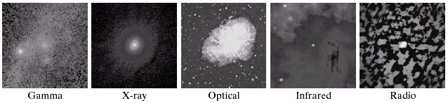
Same image captured with different modalities
Images of Crab Pulsar at the centre of the image, covering the electromagnetic spectrum
At the center of the Crab Nebula lies the Crab Pulsar, a neutron star 28–30 kilometres (17–19 mi) across with a spin rate of 30.2 times per second, which emits pulses of radiation from gamma rays to radio waves.

Slide 14
Human Visual System

Slide 15
Adaptation to different light condition

Slide 16
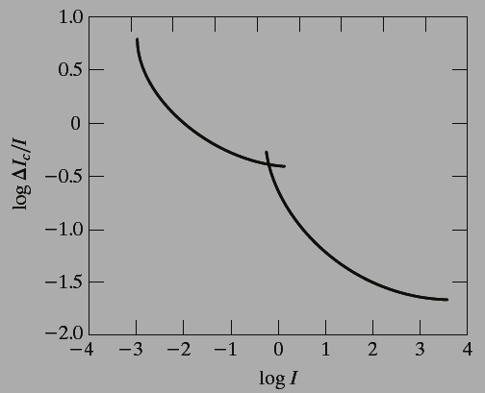
Experiment
Dark
Bright
Typical Weber ratio as a function of intensity

Slide 17
Mach band effect
Ideal
Reality

Slide 18
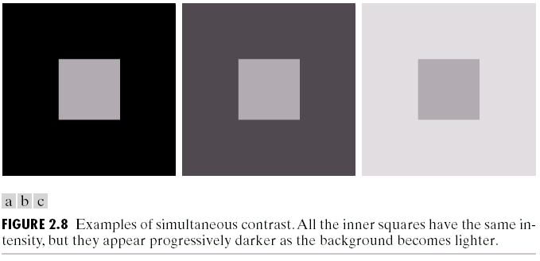

Example of Mach band effect

Slide 19
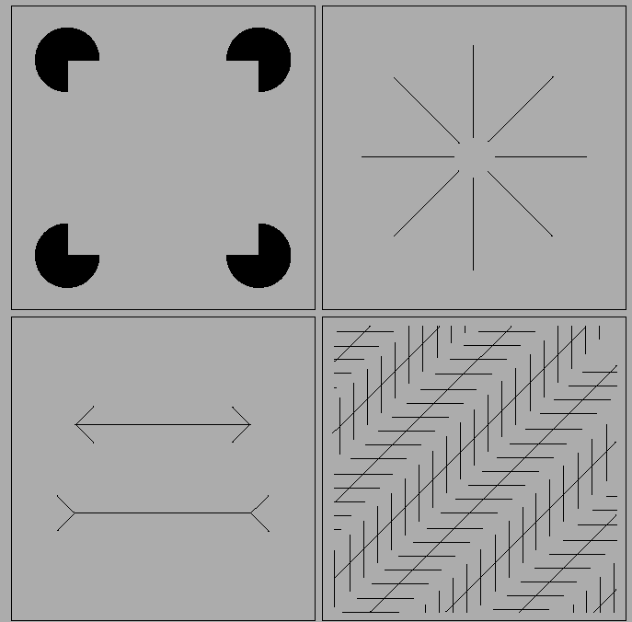
Examples of visual illusions

Slide 20
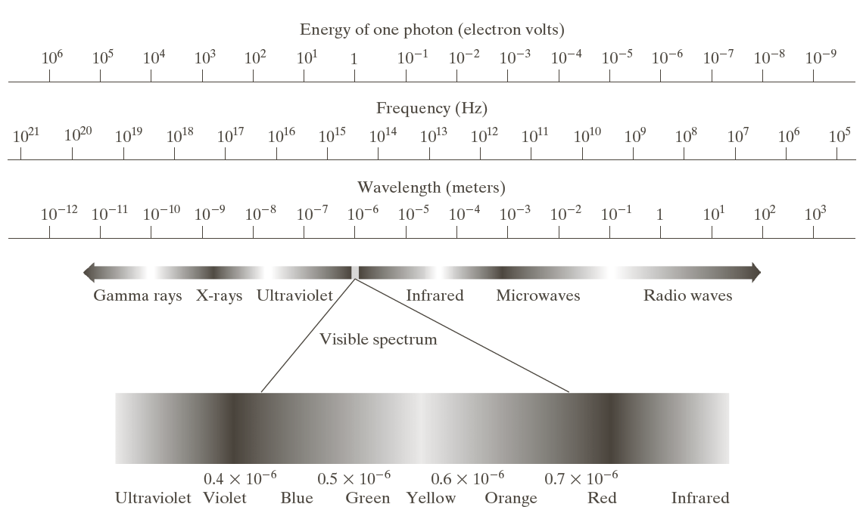
Electromagnetic spectrum

Slide 21
Image sensors
Array sensors

Slide 22
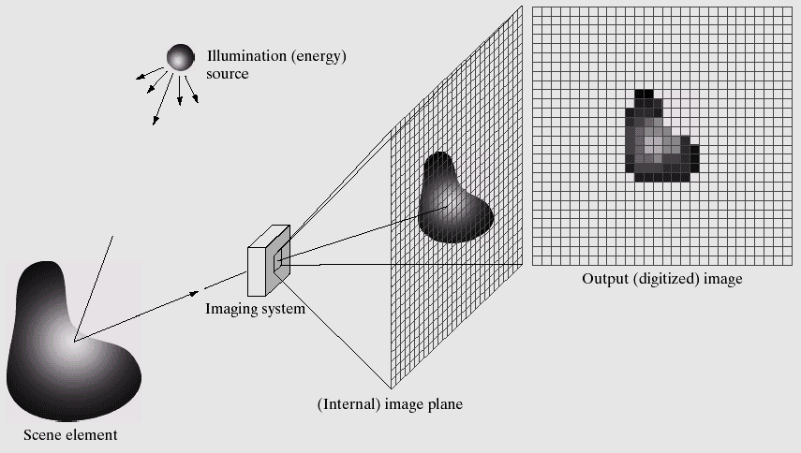
Example of Digital Image formation process

Slide 23
Example of sampling and quantization

Slide 24
Image digitization example

Slide 25
Saturation

Slide 26

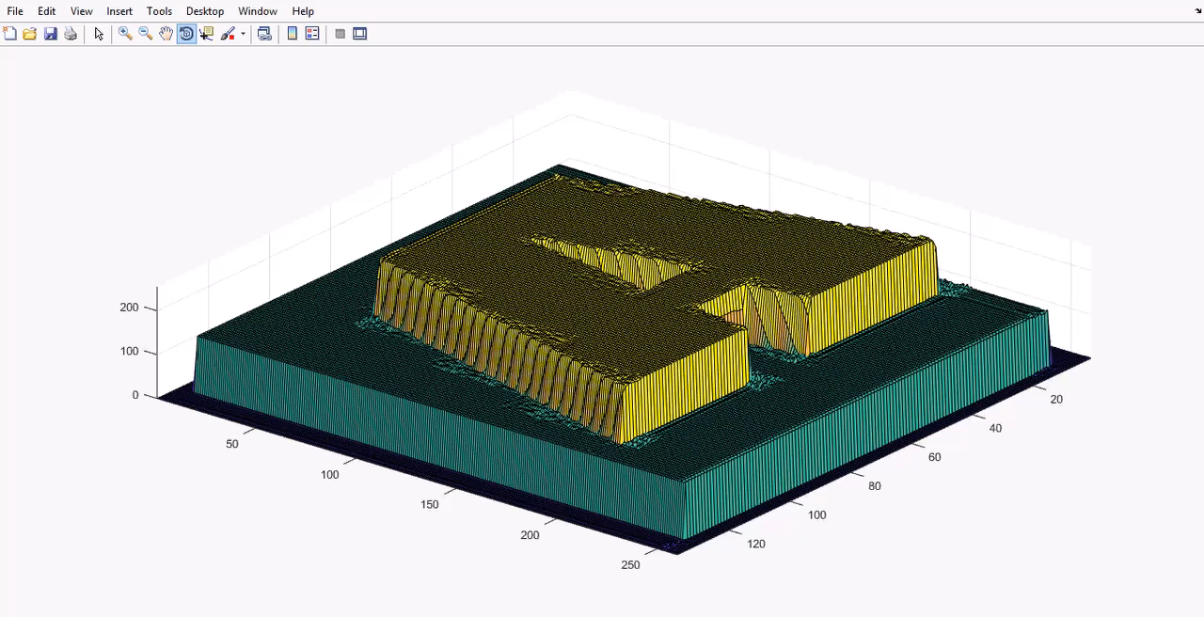
Digitization: demo

Slide 27
Thank you
Next Lecture: Image Digitization and Representation

